Slide 1
Azure SQL Database
Will Tartak
willt@VisualDataSolutions.com

Slide 2

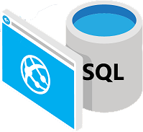
Azure SQL Database
Azure SQL Database is a cloud-based relational database service, built on the Microsoft SQL Server engine designed to deliver predictable performance and scalability, with virtually no downtime and near-zero administration.
Notes:
Azure SQL delivers predictable performance, scalability with no downtime, business continuity and data protection—all with near-zero administration. Developers can focus on rapid app development and getting their apps and solutions into production instead of managing VMs and infrastructures. Since Azure SQL is based on the Microsoft SQL Server engine, it supports existing SQL Server tools, libraries and APIs, which makes it easy for developers and organizations to extend to the cloud.

Slide 3
Common Business Differentiators
Azure SQL Database
SQL Server
You’re building new cloud-based applications to take advantage of cost savings and performance.
You need instant scalability.
You want databases replicated in different regions of the world for backup.
You want Microsoft to handle common management operations.
You want to build enterprise applications larger than 1 TB.
You have existing IT resources and can maintain stewardship over backups and database high availability.
Notes:
Although there are a number of differences between Azure SQL and SQL Server, the primary differences have more to do with scale and resources than actual features. For developers there are minor differences in development, mostly around T-SQL variations, Most of the Transact-SQL features that applications depend on are supported in both Microsoft SQL Server and Azure SQL. Some unsupported features are data types, operators, as well as string, arithmetic, logical, and cursor functions. Another important difference is that Azure SQL is designed to isolate features from any dependency on the master database, and so some server-level activities are unsupported. NOTE: Features that are deprecated in SQL Server are generally not supported in Azure SQL.

Slide 4

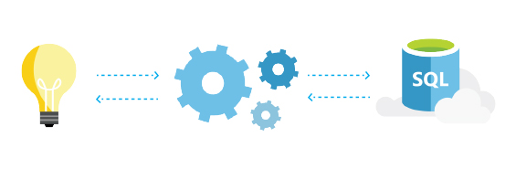
Azure SQL Database Development
ADO.NET
Java
PHP (Windows only)
Node.js
Python
Ruby
Notes:
You don't have to learn a whole new set of tools to get started with Azure SQL. You can leverage open source tools like cheetah, sql-cli, VS Code. Additionally, Azure SQL works with Microsoft tools like Visual Studio and SQL Server Management Studio. You can also use the Azure Management Portal, PowerShell, and REST APIs help you gain additional productivity.

Slide 5
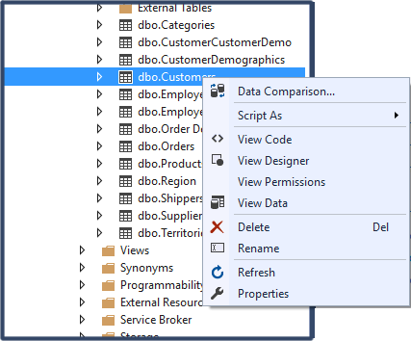
Getting Data
In almost every case, working with Azure SQL Database data is exactly the same as working with SQL Server data.
Rich and up-to-date transact-SQL (T-SQL) support
Stored procedures, user-defined functions, triggers, and views
Newest features from SQL Server 2016
Notes:
If you’re new to relational database development, tools are in place, including robust graphical experiences, to make sure your able to do what you need to do without learning deep-level scripting. If you're a database development pro, you’ll be right at home working in the environments of your choice, including SQL Server Management Studio and Visual Studio 2105.

Slide 6
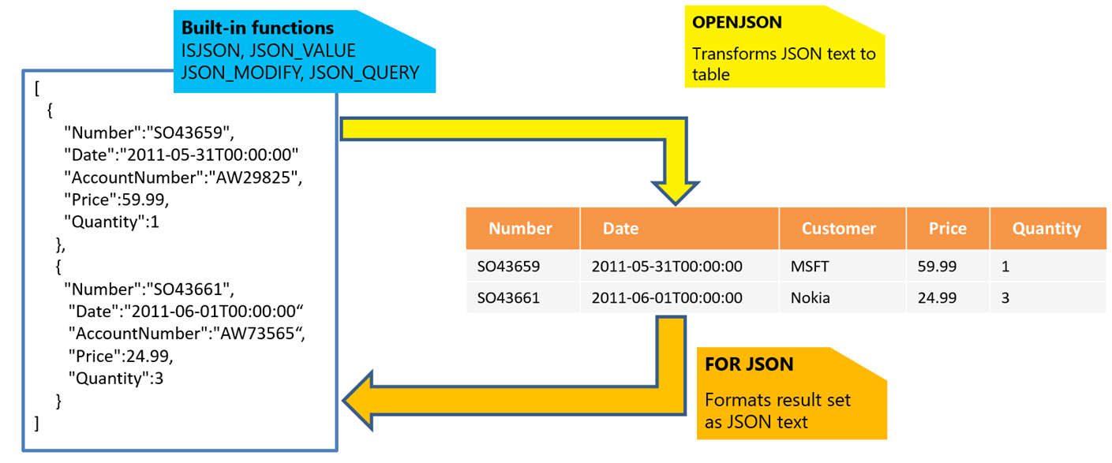
Full JSON Support
Just like other Azure services, such as Azure Search and Azure Storage, Azure SQL Database has REST endpoints that return or consume JSON.
Notes:
JavaScript Object Notation, or JSON, is a popular data format used for exchanging data in modern web and mobile applications as well as storing semi-structured data in log files or in NoSQL databases like Azure DocumentDB. Azure SQL lets you work with JSON data easily and integrate your database with modern services, including support for full relational data export.

Slide 7
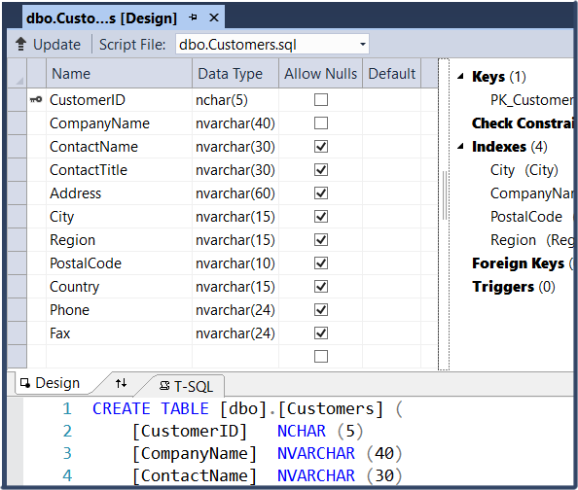
Developing Solutions
Every Azure SQL Database task, script, method, function and process can be created and managed in Visual Studio 2015 using SQL Server Data Tools for Visual Studio 2015. This includes managing permissions, masks, and encryption.
Notes:
Every Azure SQL task, script, method, function and process can be created and managed in Visual Studio 2015 using SQL Server Data Tools for Visual Studio 2015. This includes managing permissions, masks, and encryption. Azure SQL is a perfect scenario for leveraging standard development concepts found in the Entity Framework as well as newer paradigms like “code first” database design and deployment.

Slide 8
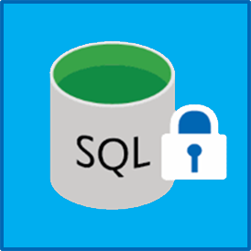
Encryption
Azure SQL Database supports “always encrypted” as well as “transparent” encryption to secure your data by performing real-time encryption and decryption of the database, associated backups, and transaction log files at rest without requiring changes to the application.
Notes:
Always Encrypted is a new data encryption technology in Azure SQL Database and SQL Server that helps protect sensitive data “at rest” on the server, during movement between client and server, and while the data is in use. Always Encrypted ensures that sensitive data never appears as plaintext inside the database system. After you configure data encryption, only client applications or app servers that have access to the keys can access plaintext data.

Slide 9
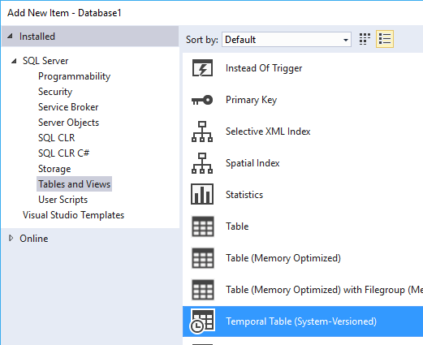
Temporal Tables
Temporal Tables provide administrators and developers the ability to track and analyze historical changes in data, similar to concepts of versioning, and even allow retention polices, similar to a document management system.
Notes:
Integration of temporal tables can be totally managed via the portal without writing any code, or enhanced and integrated via scripts and code. Temporal Tables makes it easy to connect data to a “time context” so that stored records can be evaluated within specific time period. This makes it easier to manage “moving” and constantly updated records, epically data aggregations, where a query can be run to show information since or “between. Since temporal tables are “system-versioned “, the system history table is typically larger than regular tables. A large history table can pose issues to cost and performance over time, so Azure SQL also exposes retention policy features, just like in a document management system to clear out history based on specific criteria. Creation and management of Temporal Tables is even integrated into Visual Studio via SQL Server Data Tools.

Slide 10
Database Advisor
Database Advisor provides recommendations that can improve query performance based on impact levels.
High impact recommendations should provide the most significant performance impact.
Medium impact recommendations should improve performance, but not substantially.
Low impact recommendations should provide better performance than without, but improvements might not be significant.
Notes:
Before the Database Advisor can make recommendations it needs to have about a day of usage with reasonable. If recommendations cannot be made, the Performance Recommendations page will typically provide a message to administrators with an explanation.

Slide 11
Query Performance Insight
Query Performance Insight makes it easy to troubleshoot Azure SQL Database performance by providing query analysis information.
Deeper insight into your databases resource consumption
The ability to drill down into the details of a query, view its text and history of resource utilization
Performance tuning annotations that show actions performed by SQL Azure Database Advisor
Notes:
Before Query Store for SQL Database can provide insights performance insights it needs about two hours of data. If the database has no activity or Query Store was not active during a certain time period, the charts will be empty when displaying that time period. You may enable Query Store at any time if it is not running via the Azure Portal, code, or scripts.

Slide 12

Security
Azure SQL Database ships with row-level security, or RLS, making it easy to partition query results based on user permissions and roles.
Based on group membership or execution context
Simplifies the design and coding of security in your application
Logic is located in the database tier
Notes:
Creating logical connection between different data sources leverages the concept of relationships. A relationship enables Power BI to comprehend how tables and data structures relate to each another to ultimately design and create compelling visuals and reports. The processes of managing and adjusting these relationships across data sources is referred to as modeling, and uses the concepts of Measures, Calculated Columns, and even Calculated Tables (similar to the old fashioned notion of views.)

Slide 13
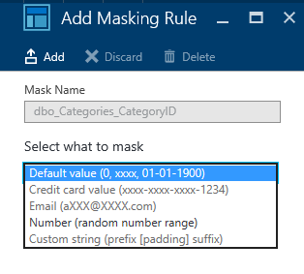
Dynamic Data Masking
Dynamic data masking prevents unauthorized access to sensitive data by “masking” fields based on roles or permissions.
Created and managed:
In the Azure Portal
Programmatically via SDKs and services
Scripting and T-SQL commands
Based on masking rules and masking functions
Notes:
Dynamic data masking helps prevent unauthorized access to sensitive data by enabling customers to designate how much of the sensitive data to reveal with minimal impact on the application layer. DDM is a policy-based security feature that hides the sensitive data in the result set of a query over designated database fields, while the data in the database is not changed. For example, a service representative at a call center may identify callers by a few digits of their social security number or credit card number, but those data items should not be fully exposed to the service representative. Masking rules can be defined that masks all but the last four digits of any social security number or credit card number in the result set of any query.

Slide 14
Hands-On Lab
Azure SQL HOL.html

